Slide 1
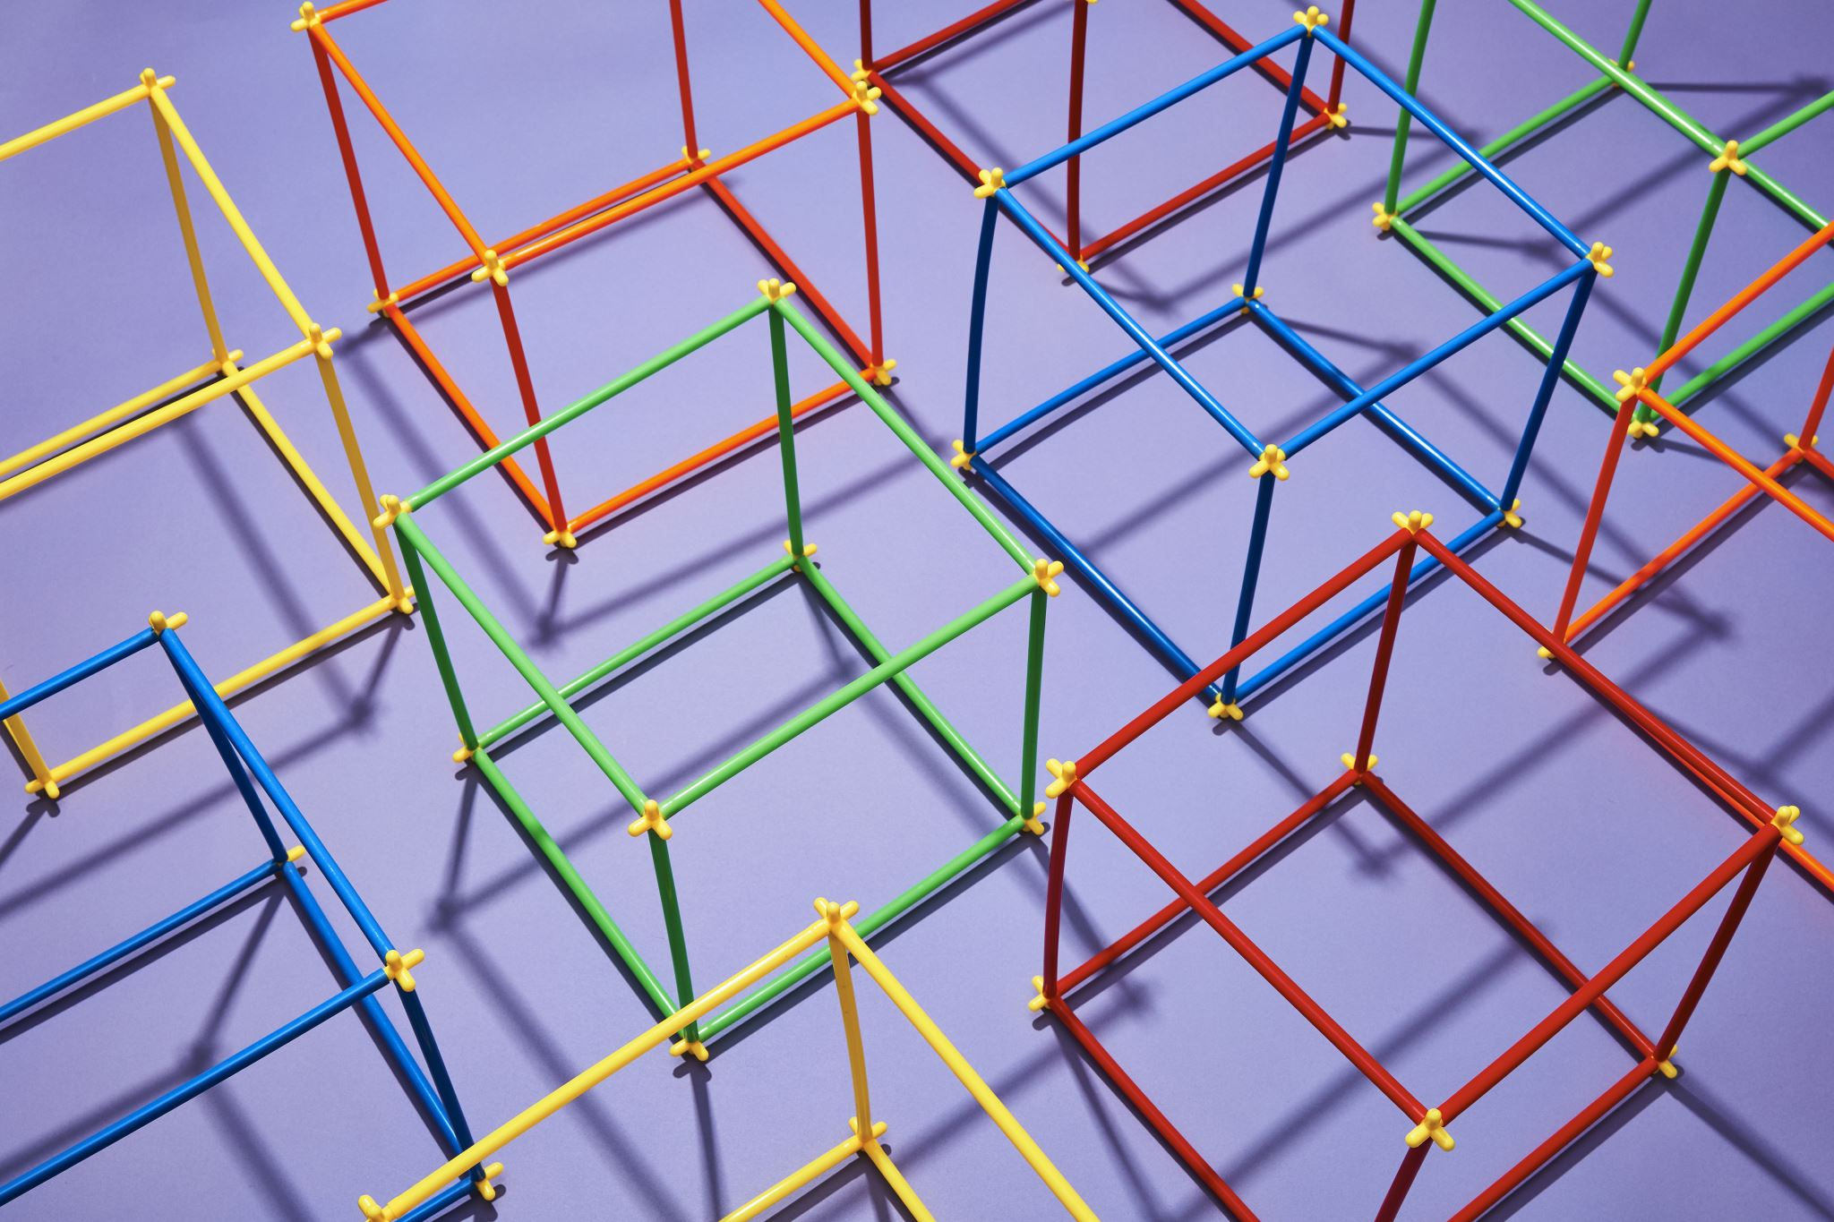
GRAPHICS

Slide 2
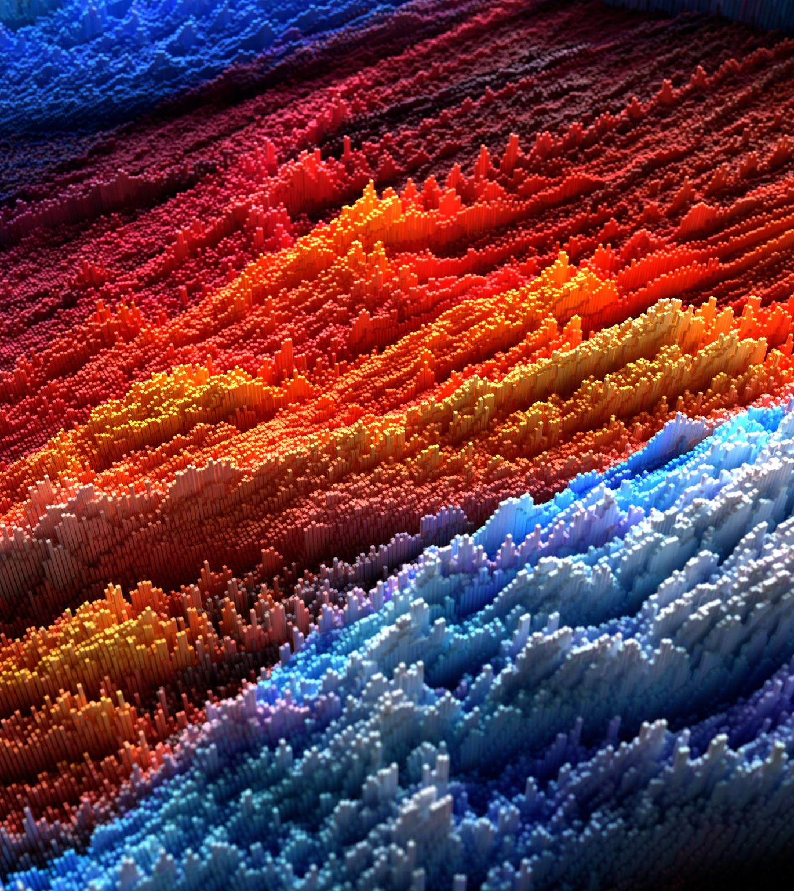
Software
Microsoft Paint/ Paint3D
Pixel Art

Slide 3

Top 11 Pixel Art Software
Photoshop - For professional users
GIMP - Can be used for complex art projects
Krita - Allows creating unique brushes
Pixlr - Saves projects automatically
Pyxel Edit - Great for static pixel art
GraphicsGale - You can work with sketches on paper
Aseprite - Newbie-friendly software
Pro Motion NG - Instruments for creating and editing titles
Pixie Engine Editor - Suitable for computer games developers
Piskel - Works both online and offline
Pixilart - For any level of experience

Slide 4
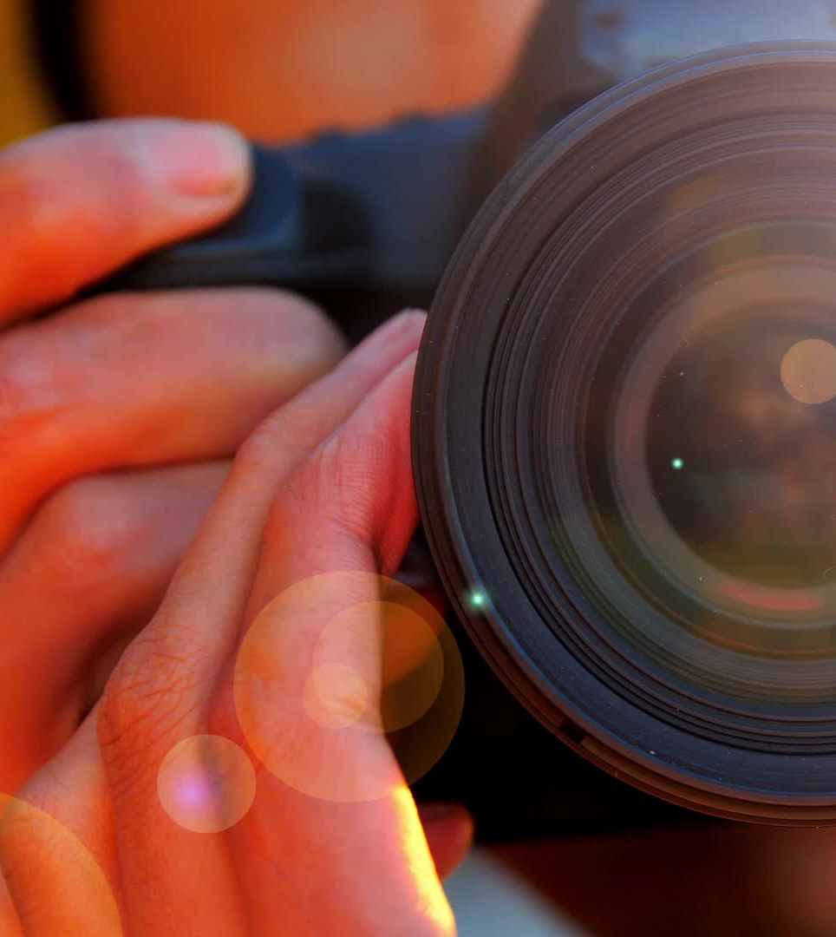
Images
Draw your image
->you own it
Insert your own photograph
->you own it
Insert an image or photograph from
The Internet –Who is the owner of the image/photograph/video??
Should/Must ask permission to use (copyright issues)

Slide 5
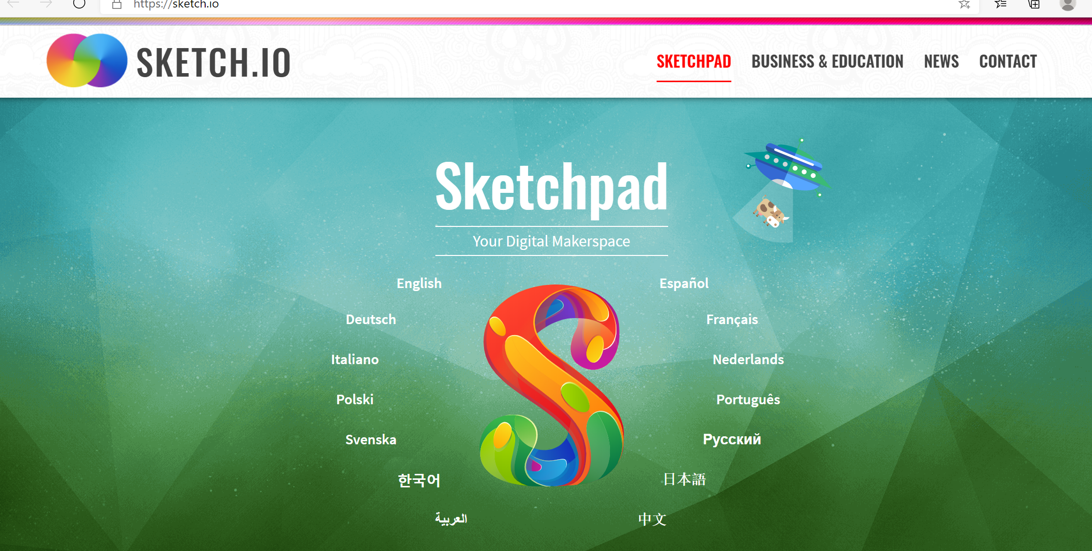
Suggested Software - https://sketch.io

Slide 6
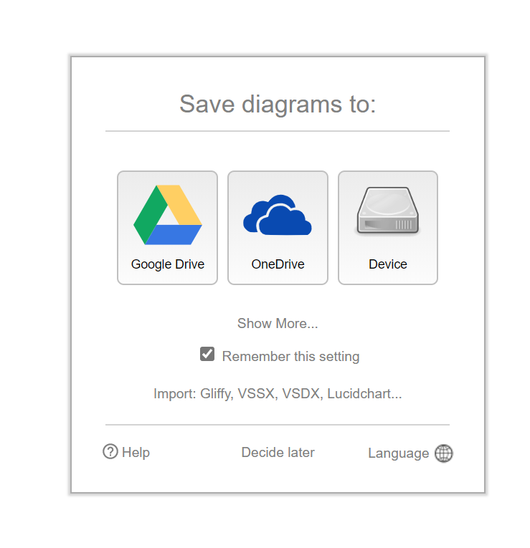
Suggested Software – https://draw.io

Slide 7
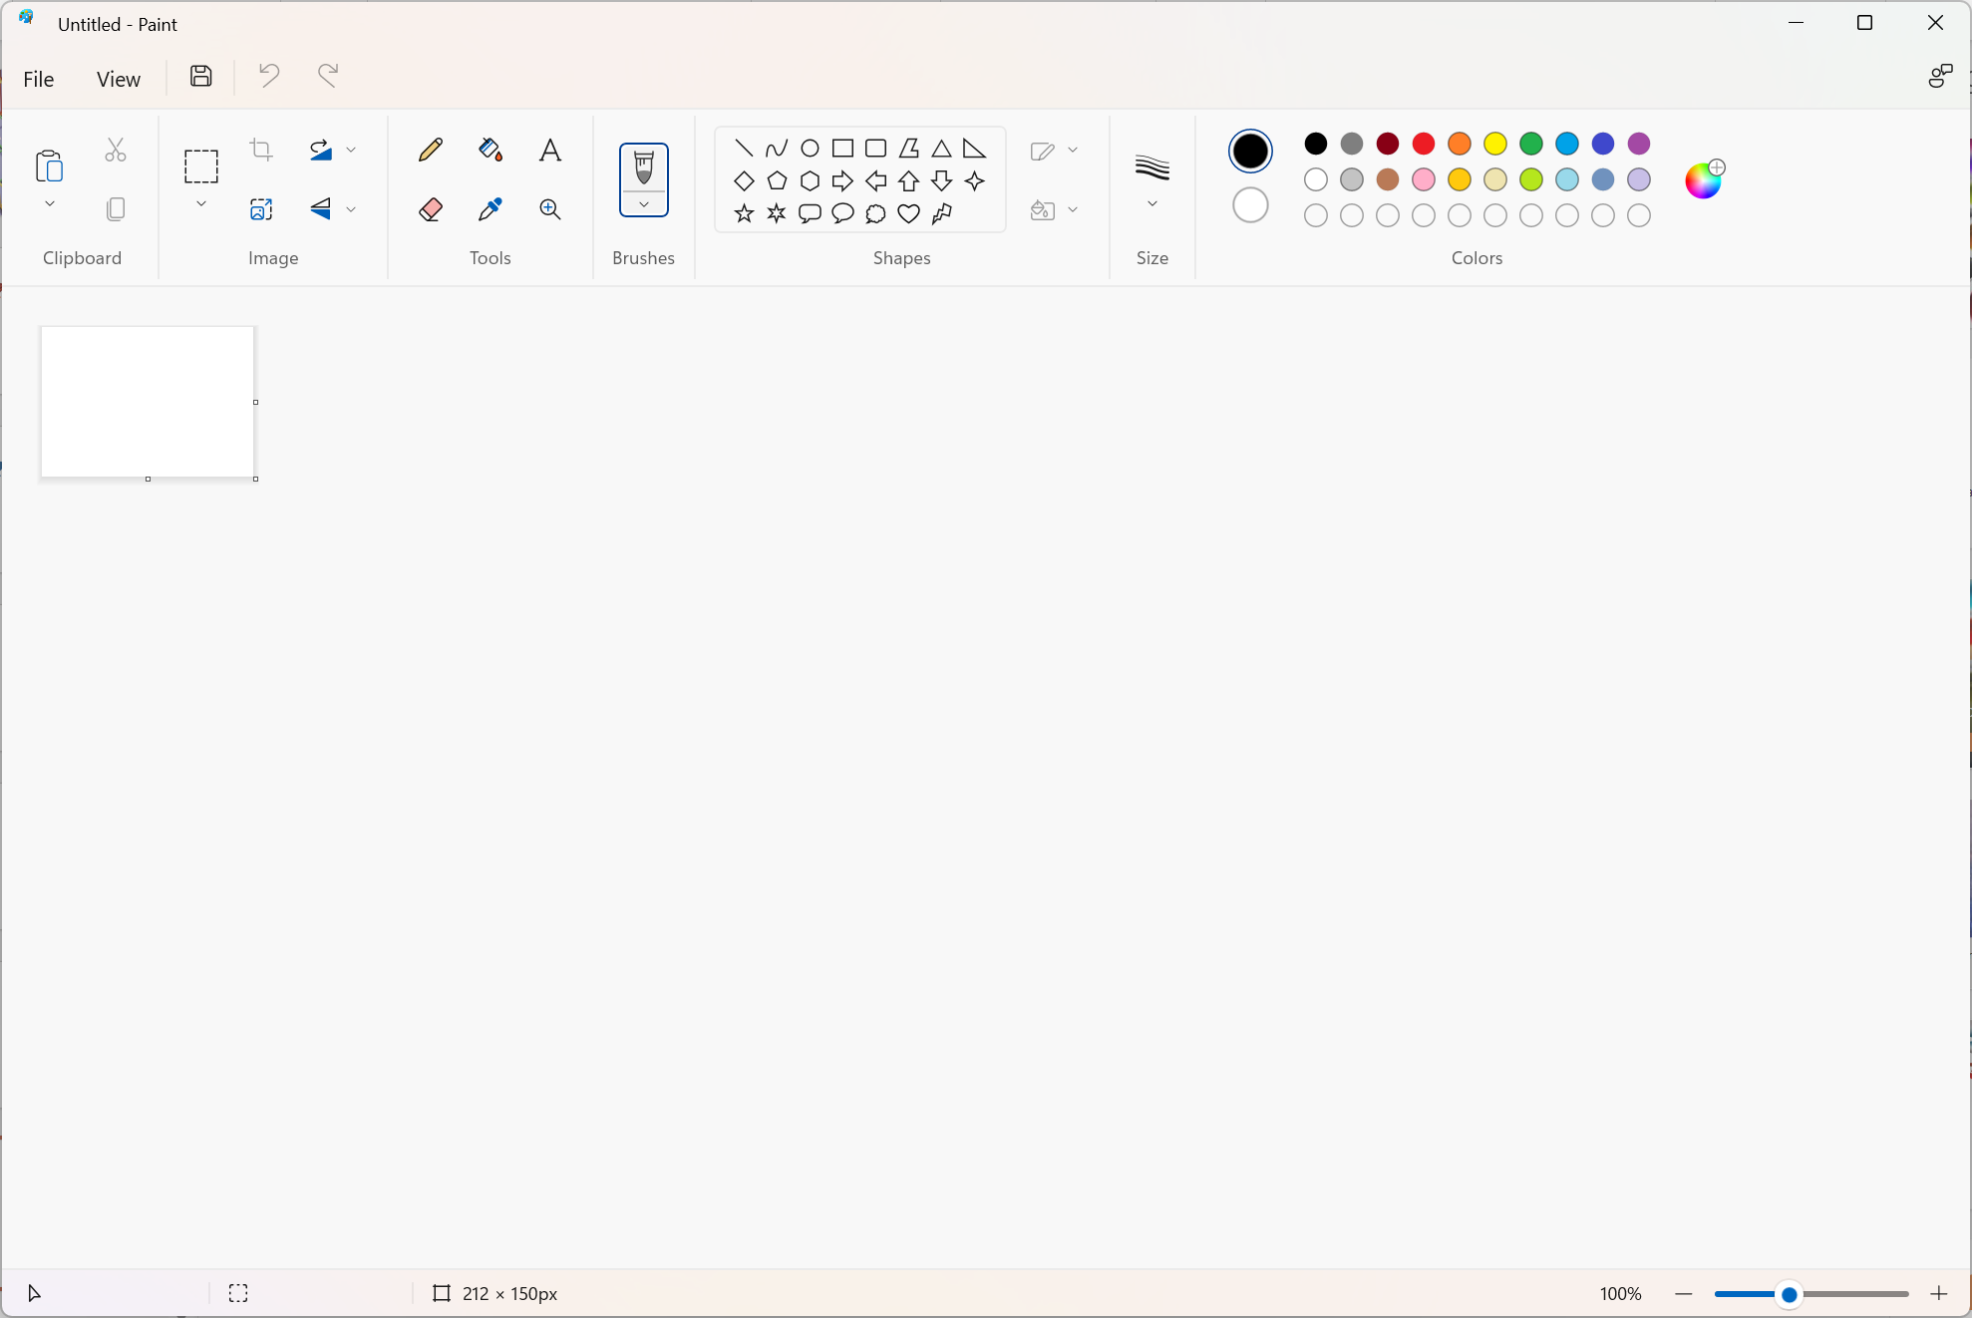
MS Paint

Slide 8
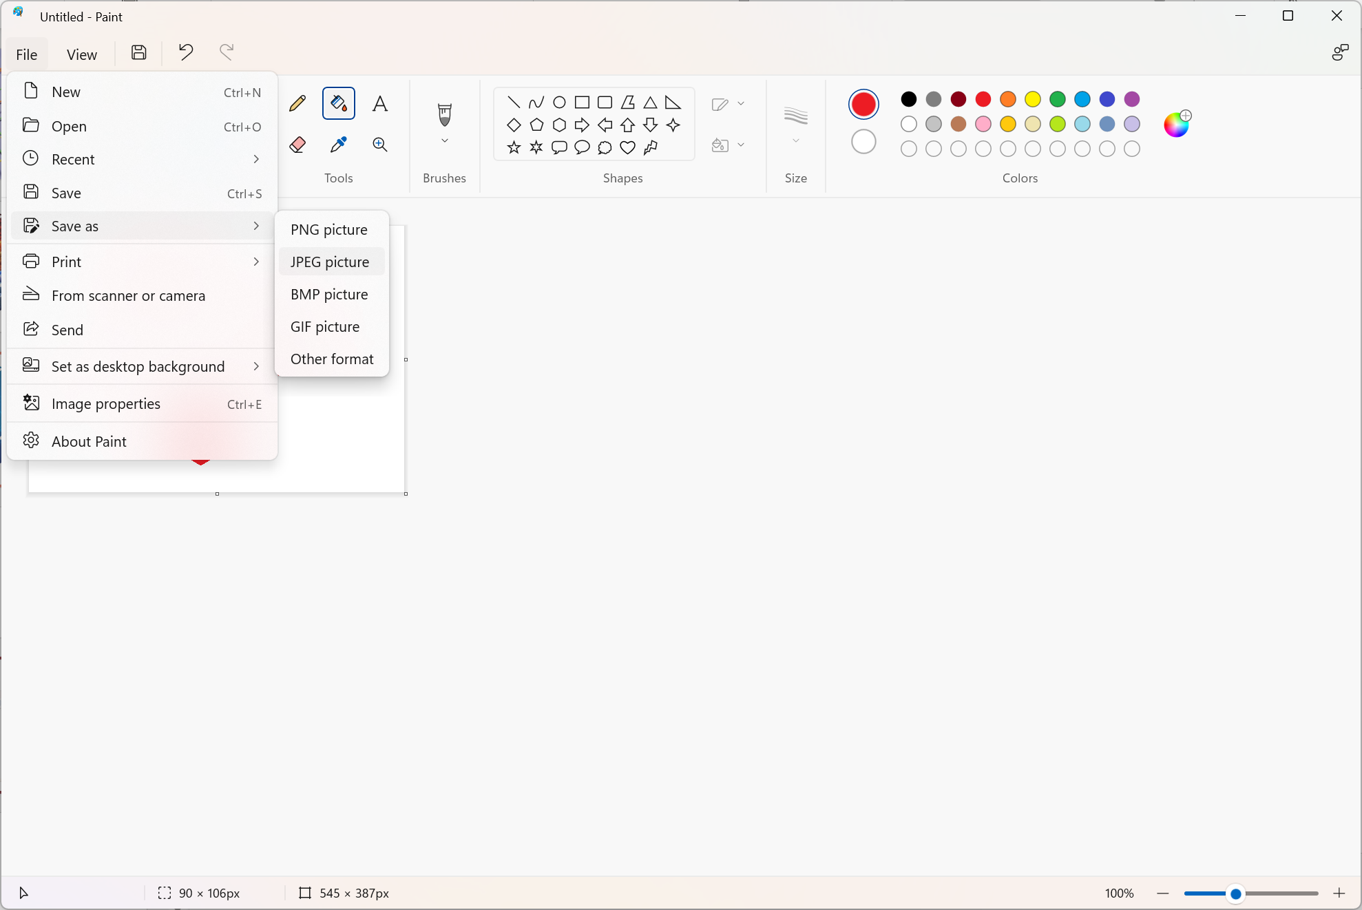
MS Paint

Slide 9
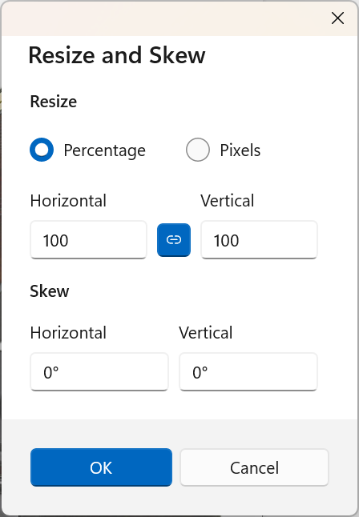
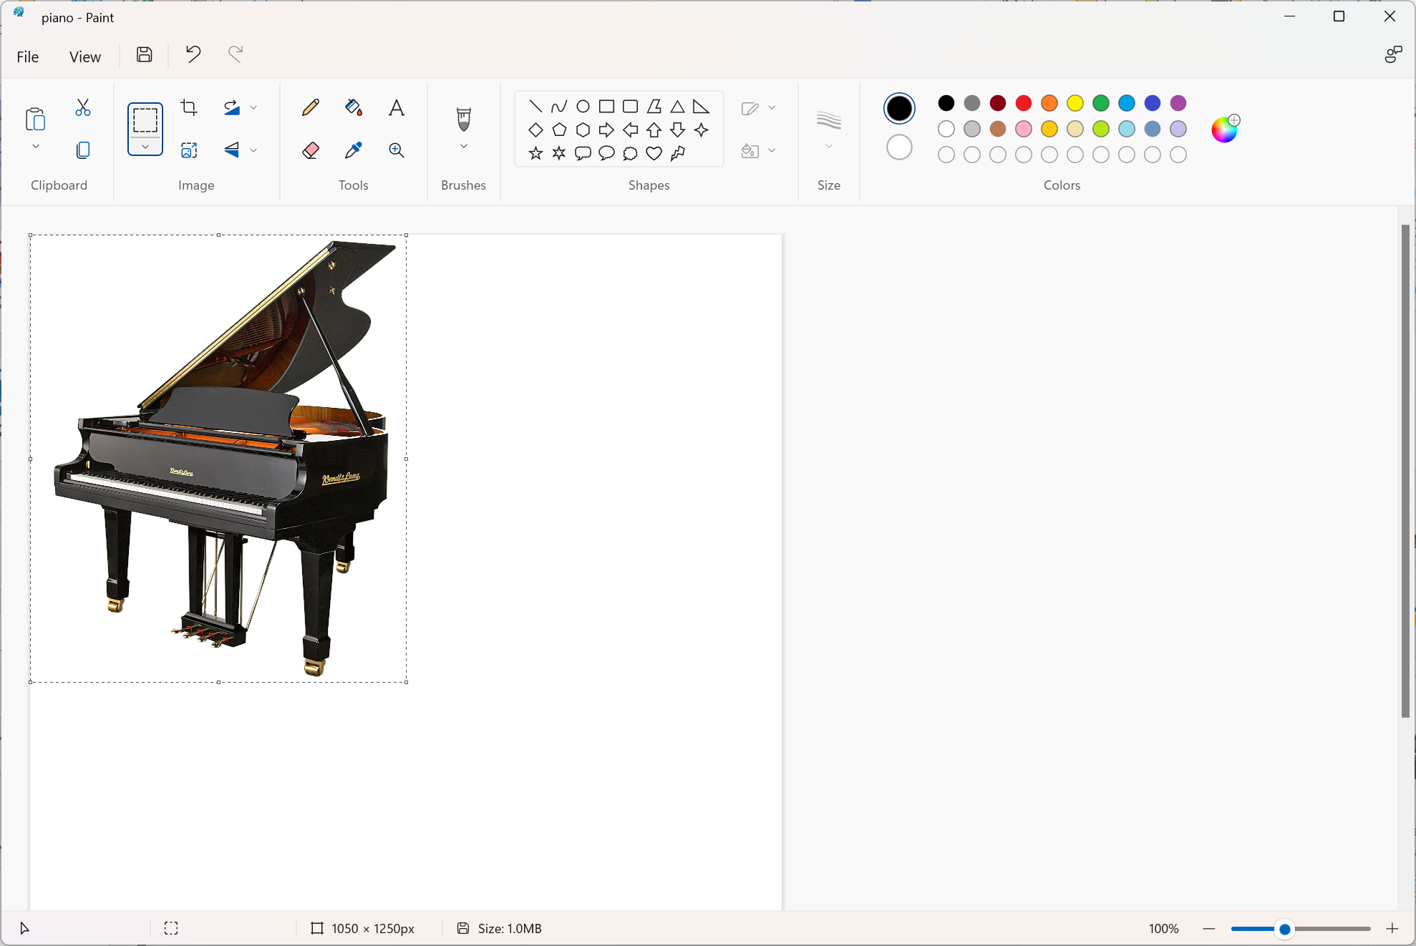
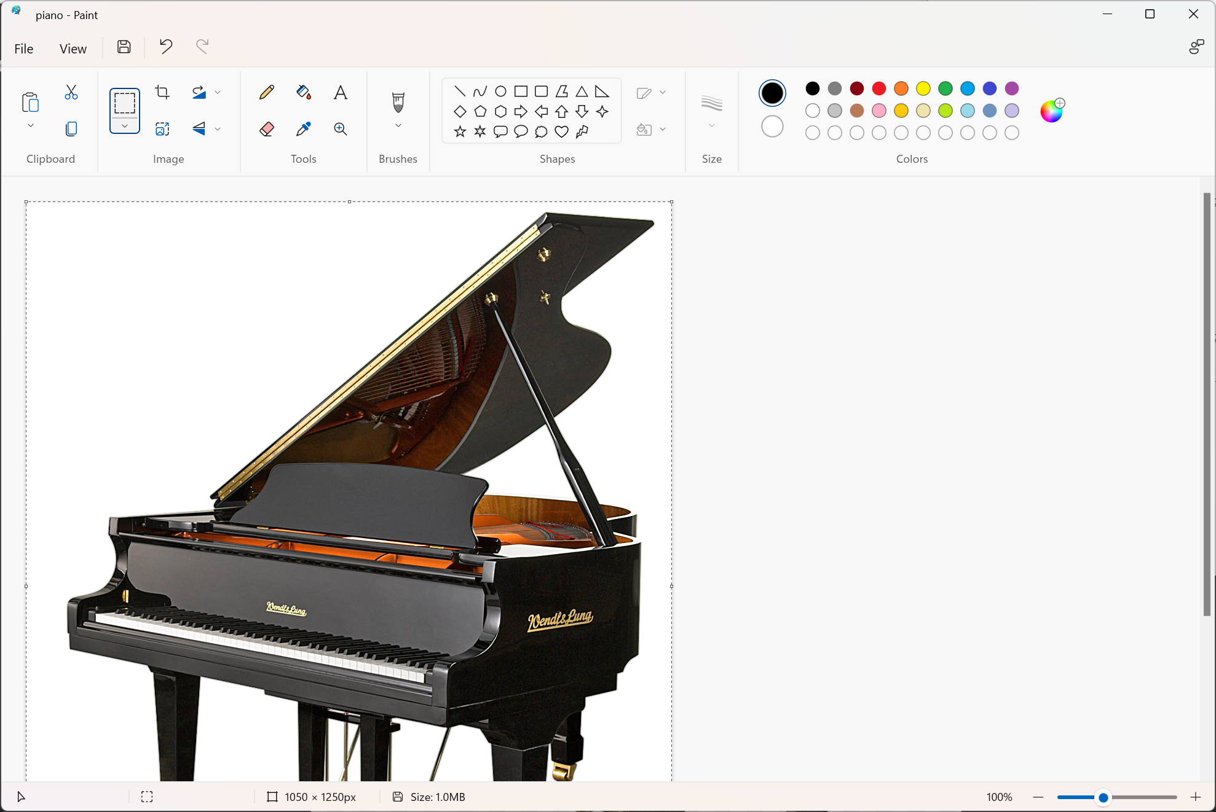
MS Paint

Slide 10
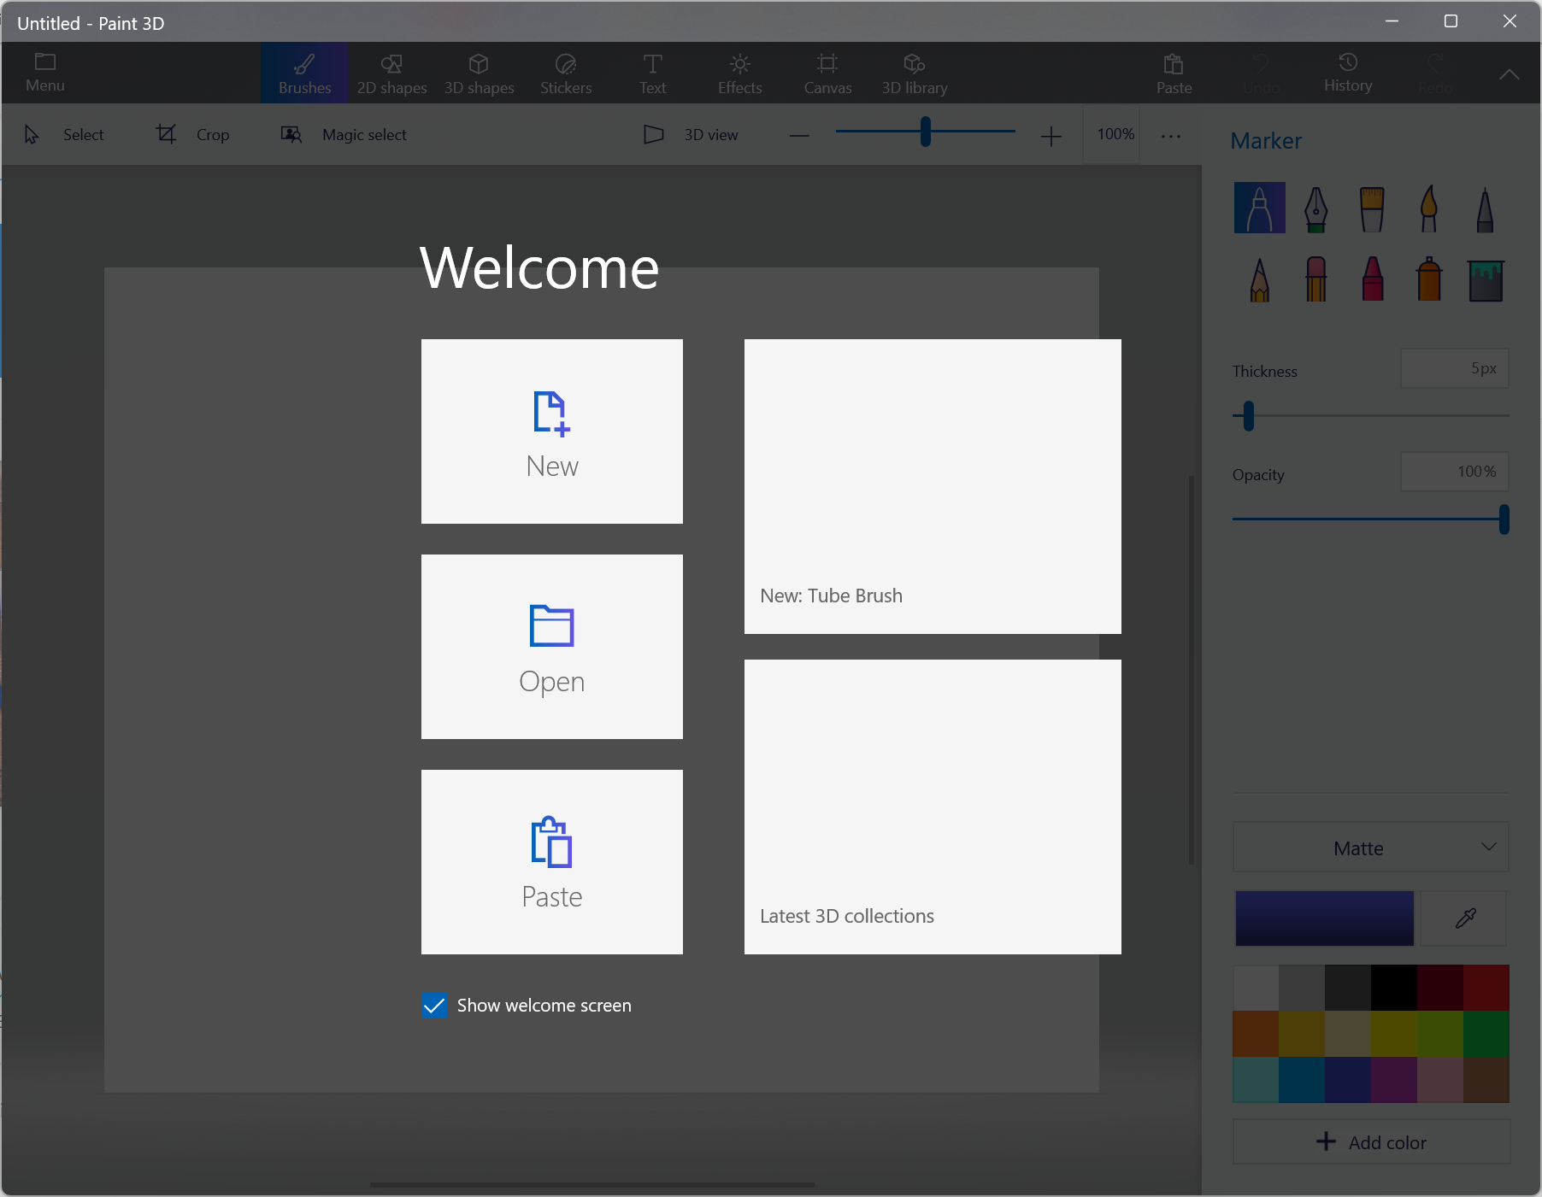
Paint 3D -> visit: Paint 3D - Microsoft Store Apps

Slide 11
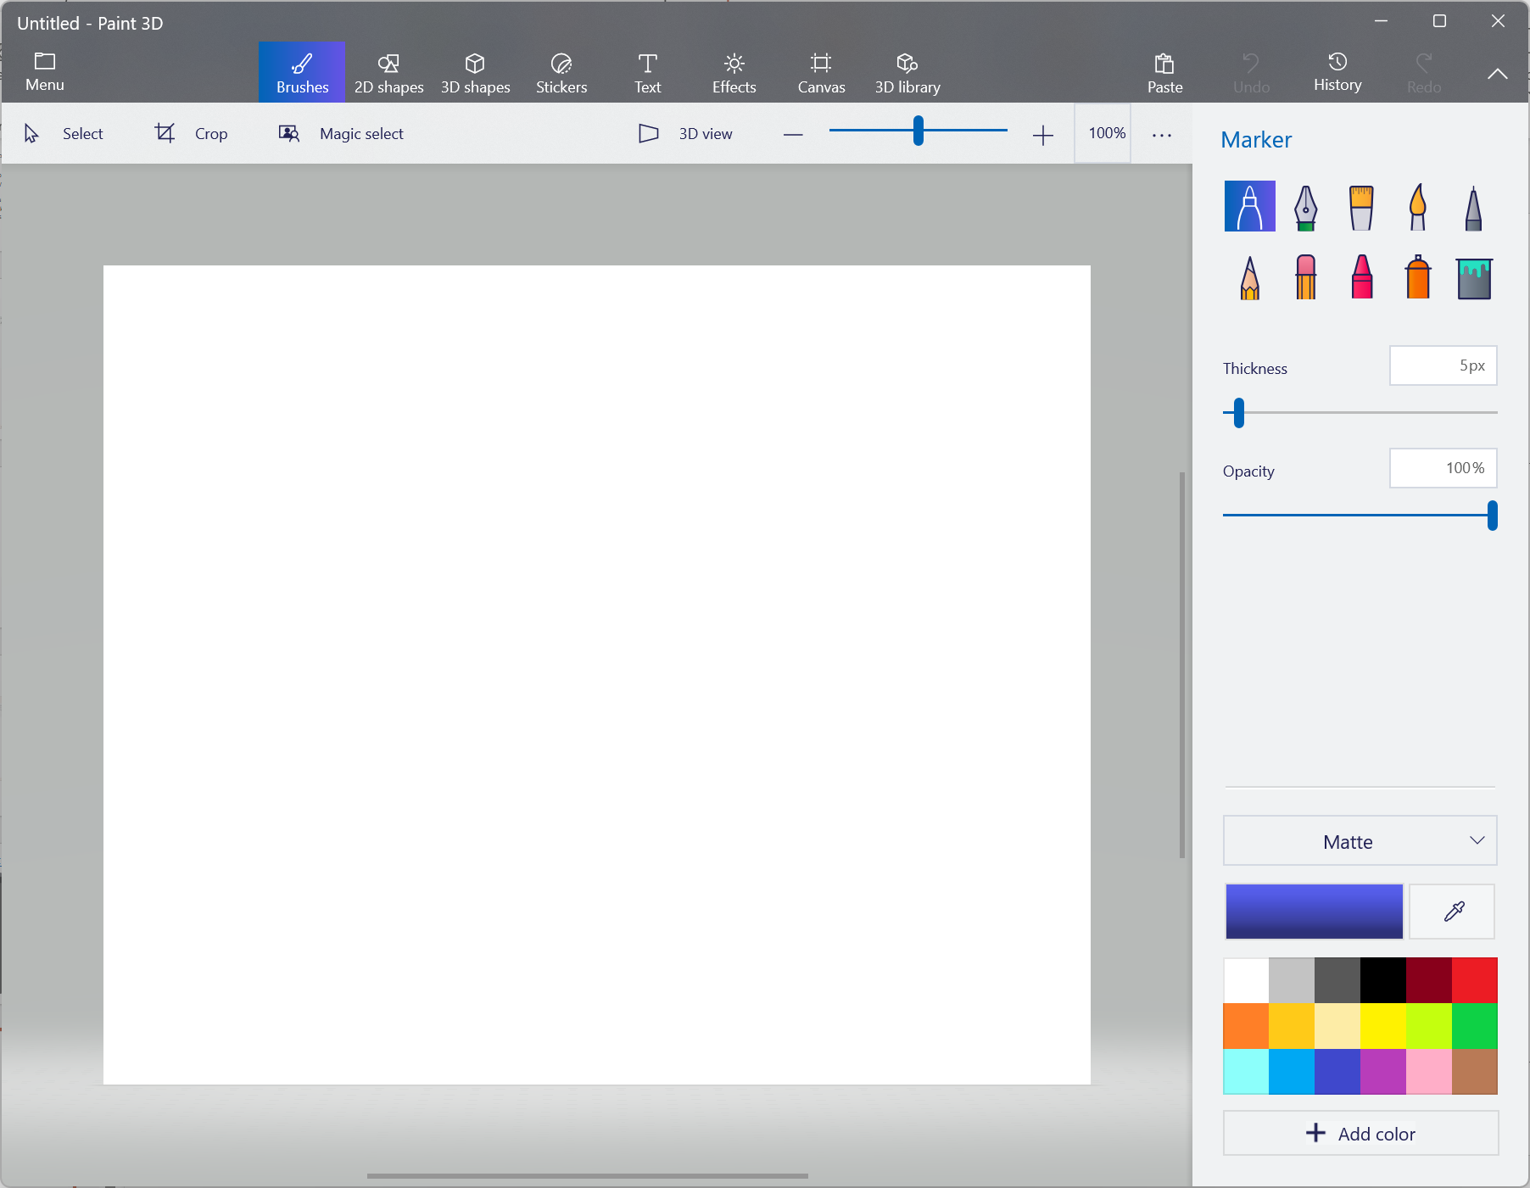
Paint 3D -> after clicking New ->->

Slide 12
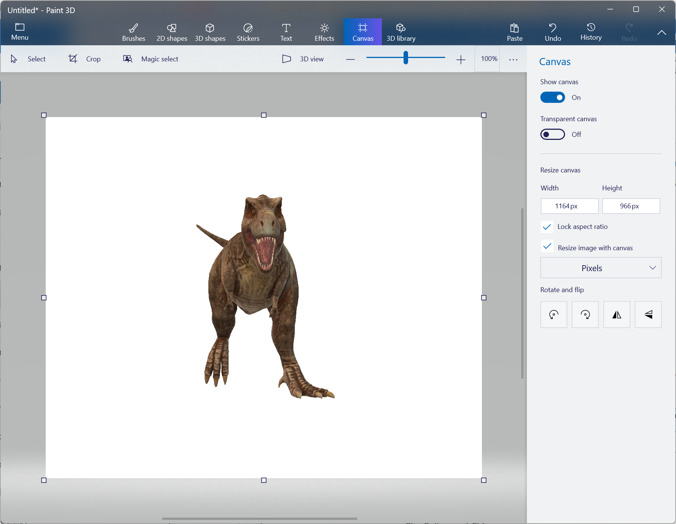
Paint 3D -> 3Dlibrary ->choose a picture

Slide 13
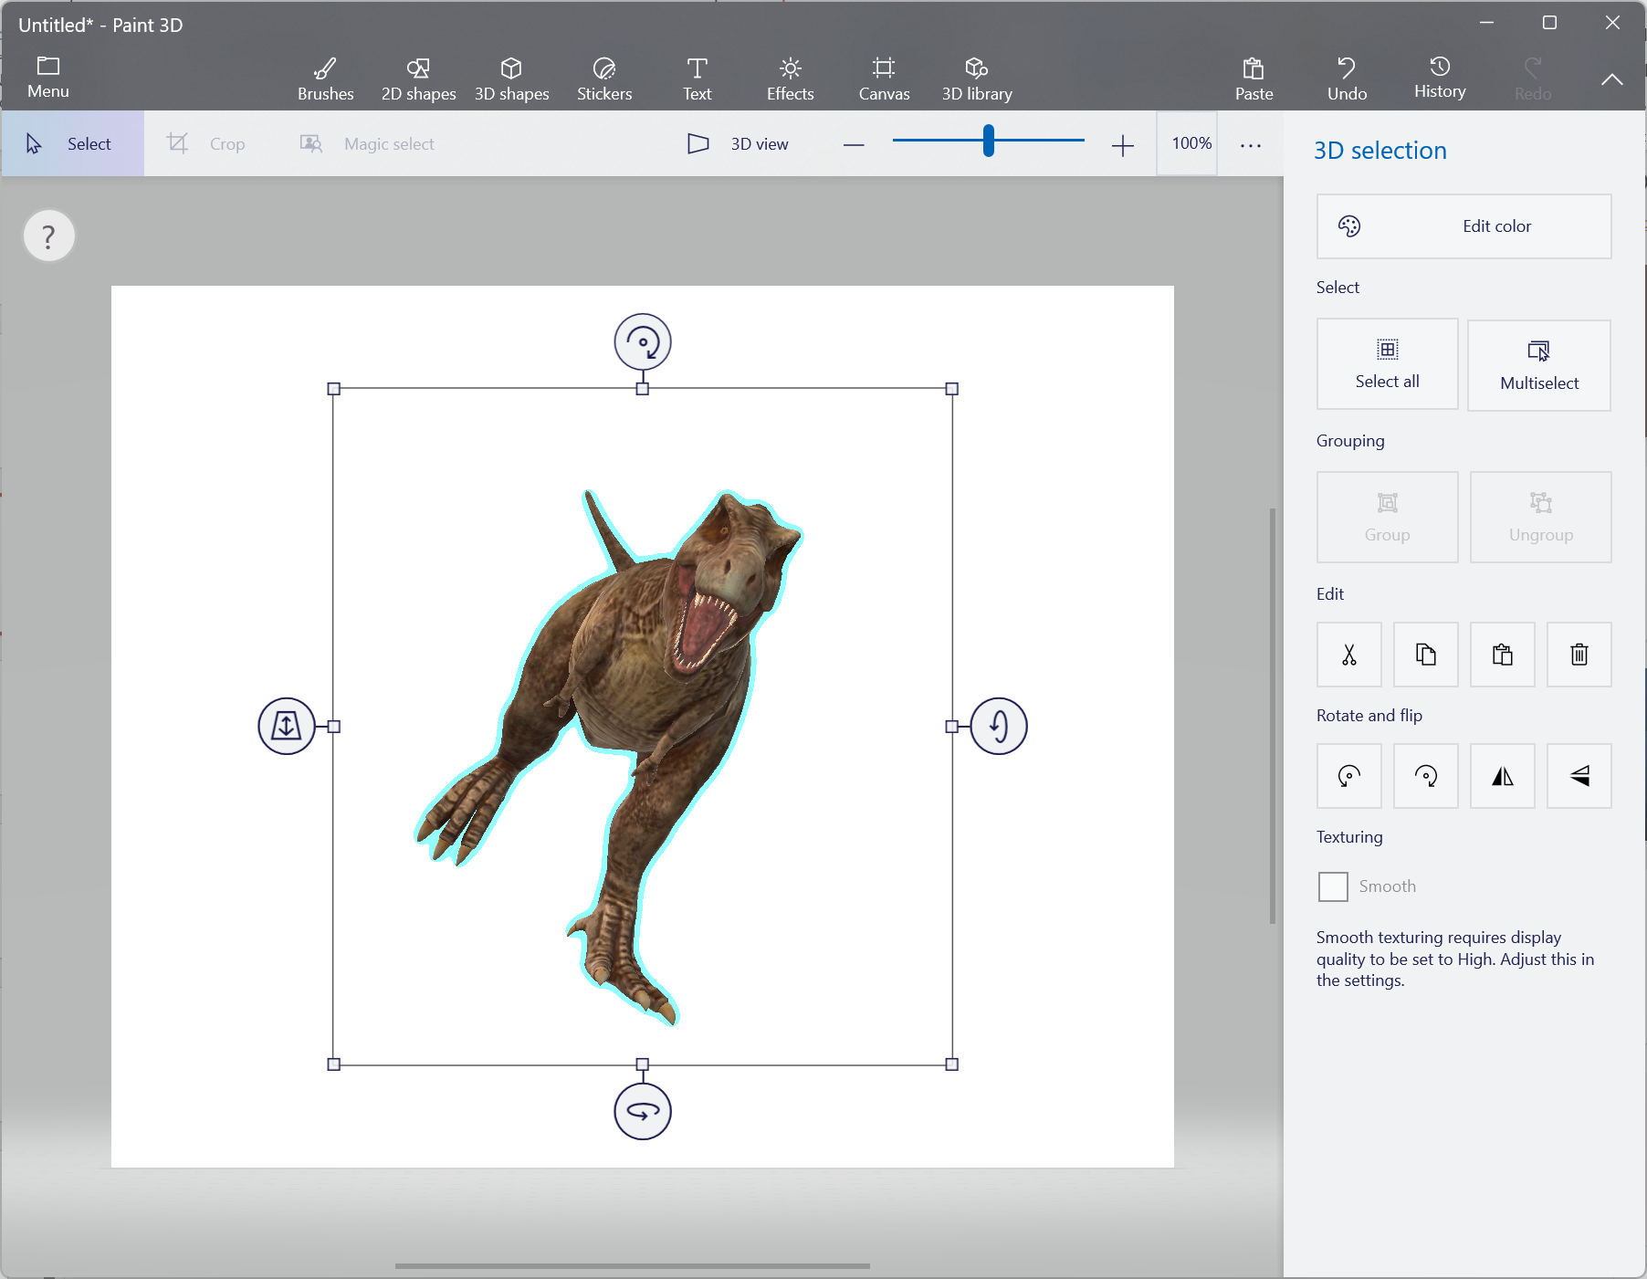
Paint 3D -> rotate object

Slide 14
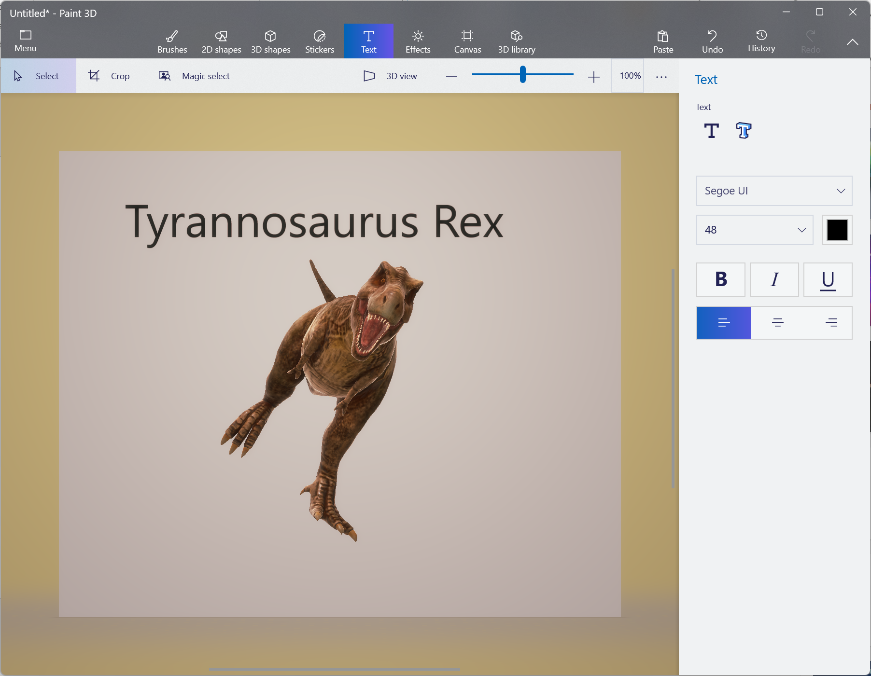
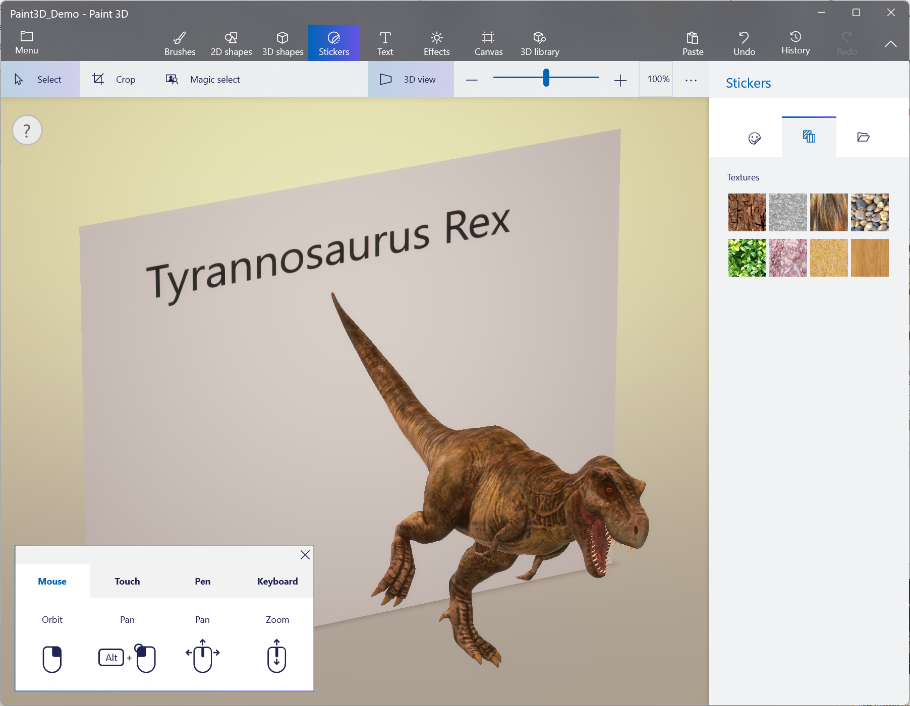
Paint 3D-Media Mix->added text

Slide 15
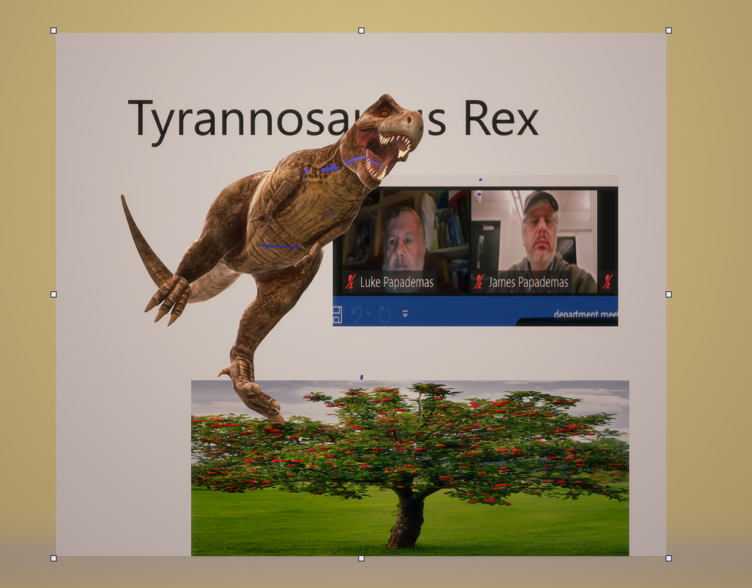
Paint3D

Slide 16
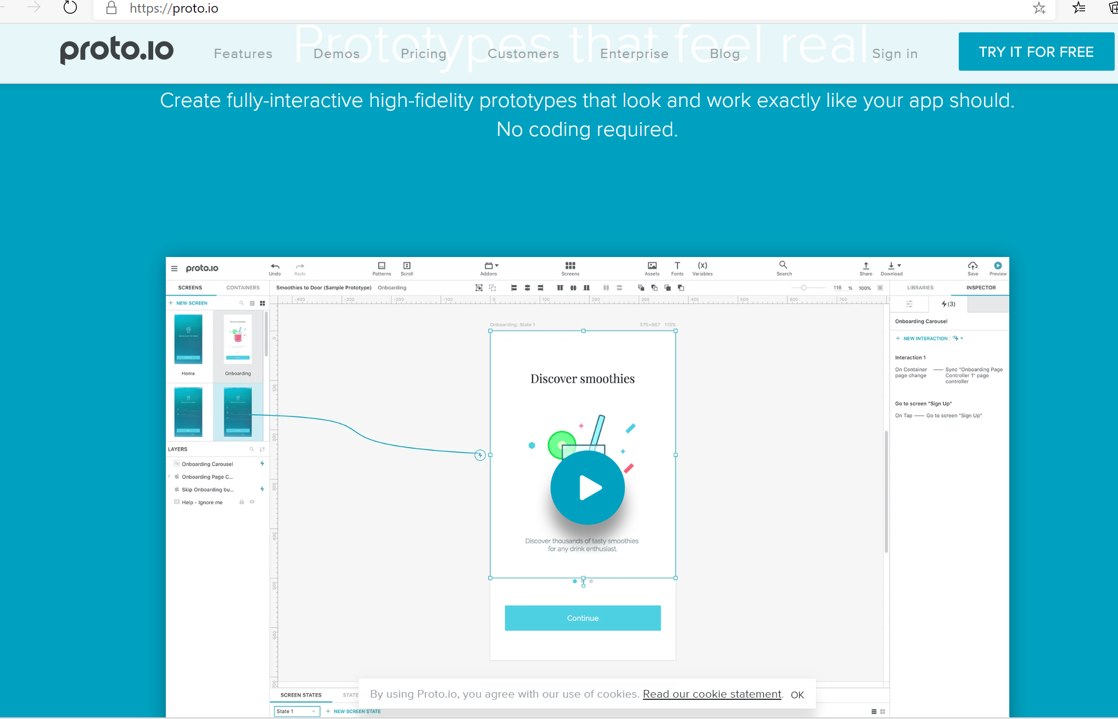
Suggested Software – https://proto.io

Slide 17
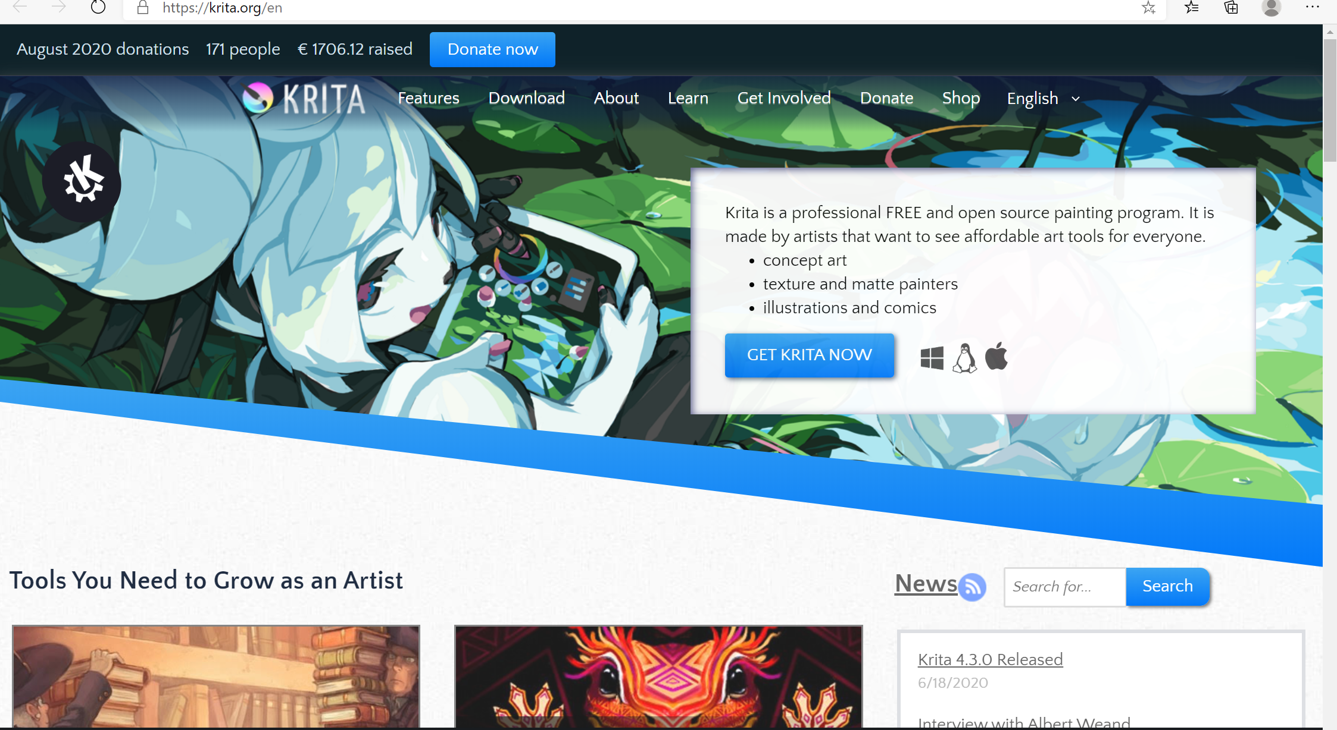
Suggested Software – https://krita.org/en

Slide 18
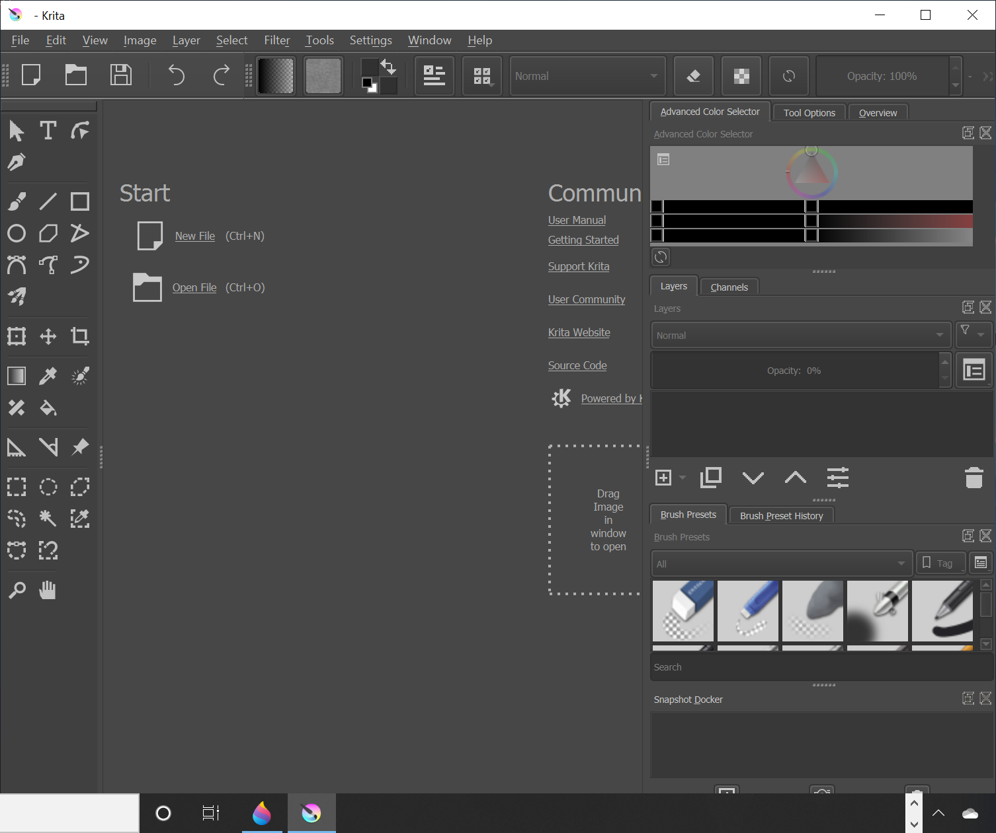
Suggested Software – https://krita.org/en

Slide 19
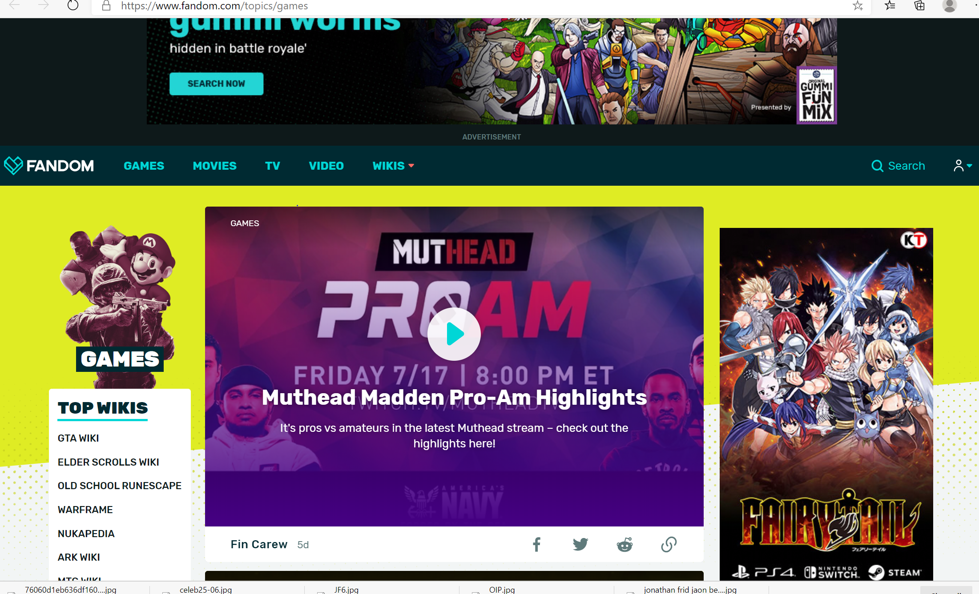
Suggested Software – https://www.fandom.com/topics/games

Slide 20
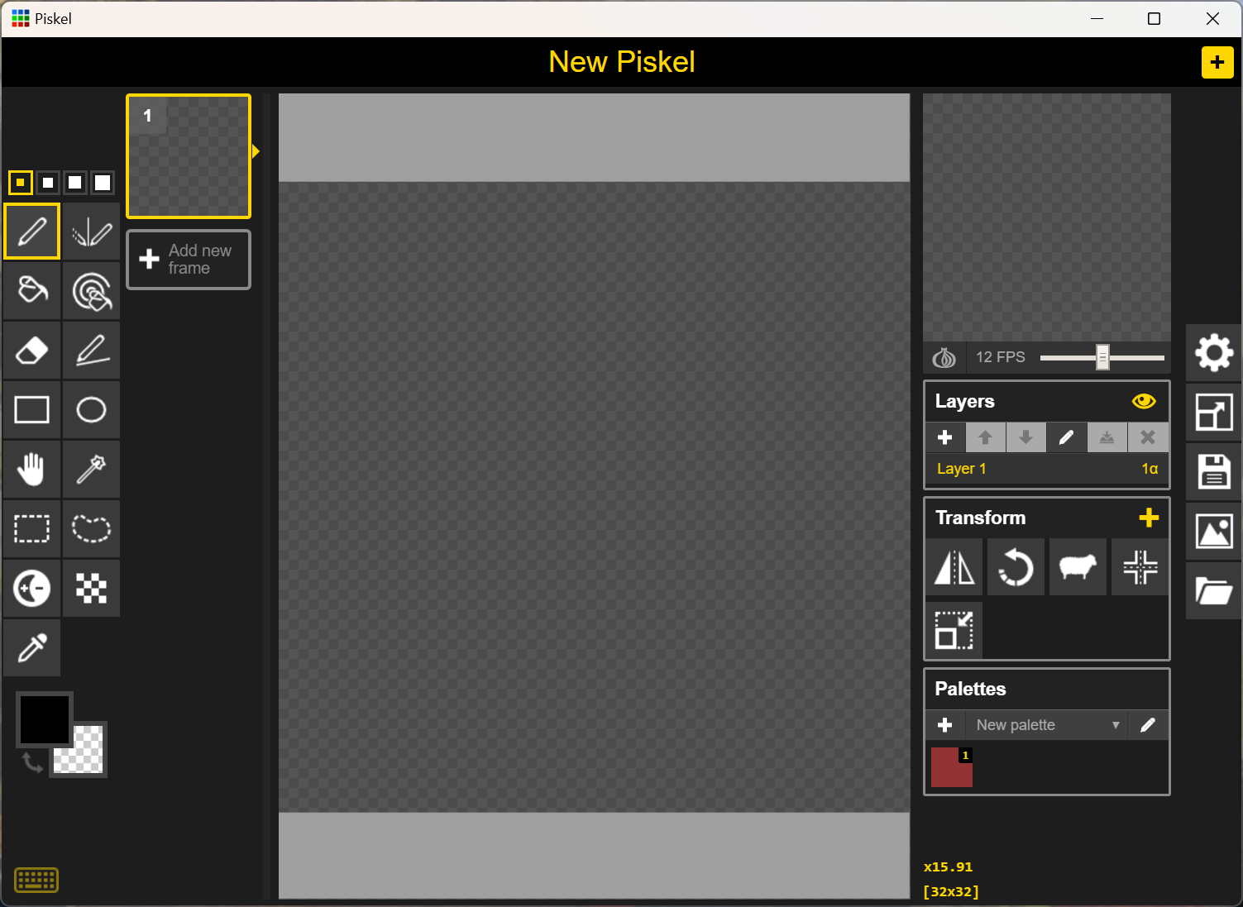
Piskel -> visit: Piskel - Free online sprite editor (piskelapp.com)
Tools ->
Layers
Transform
Palettes

Slide 21
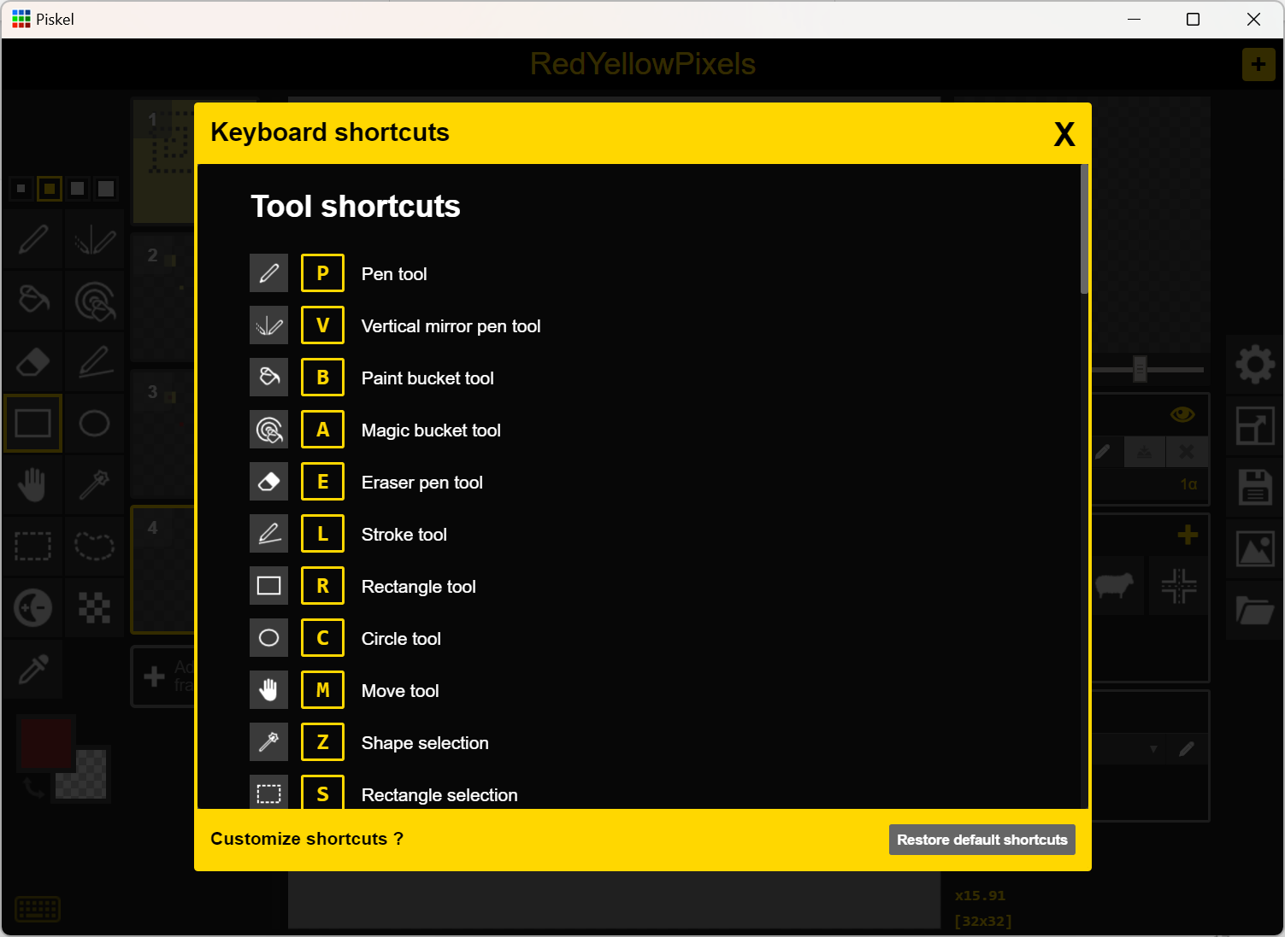
Piskel->Keyboard Shortcuts -> click on lower left keyboard image

Slide 22
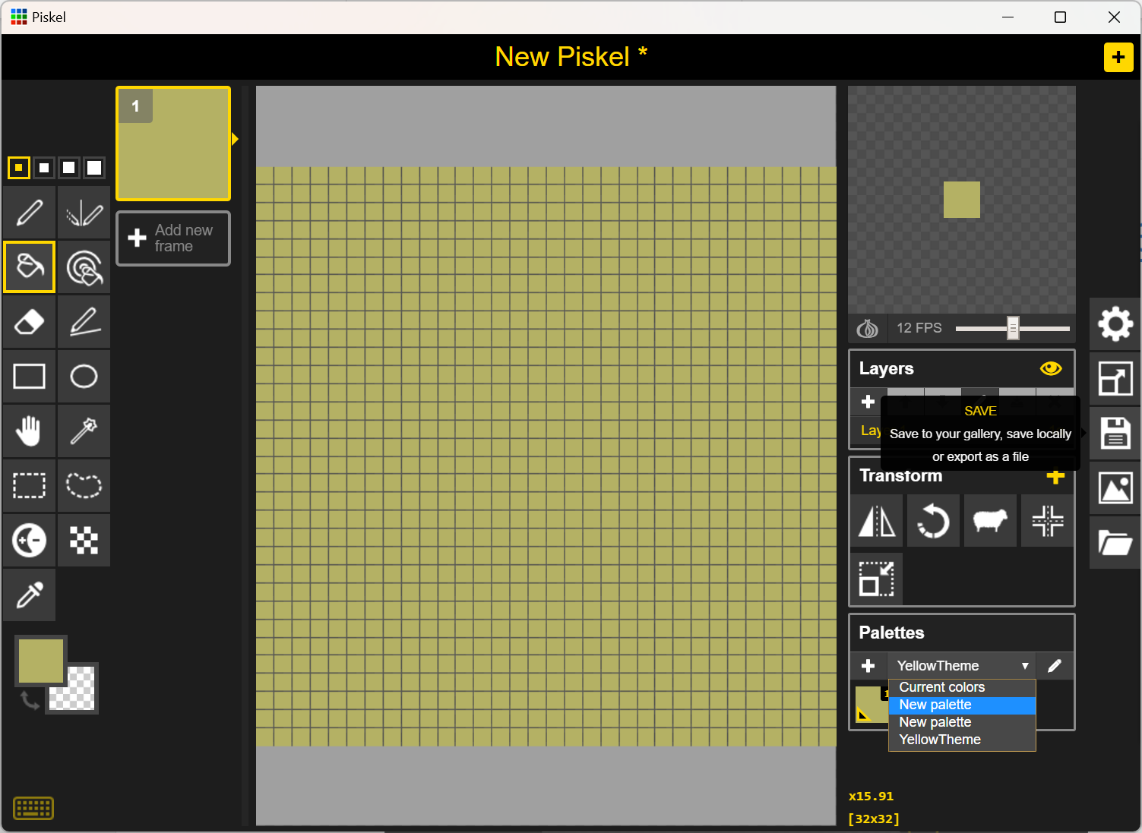
Piskel -> change palette color for background

Slide 23
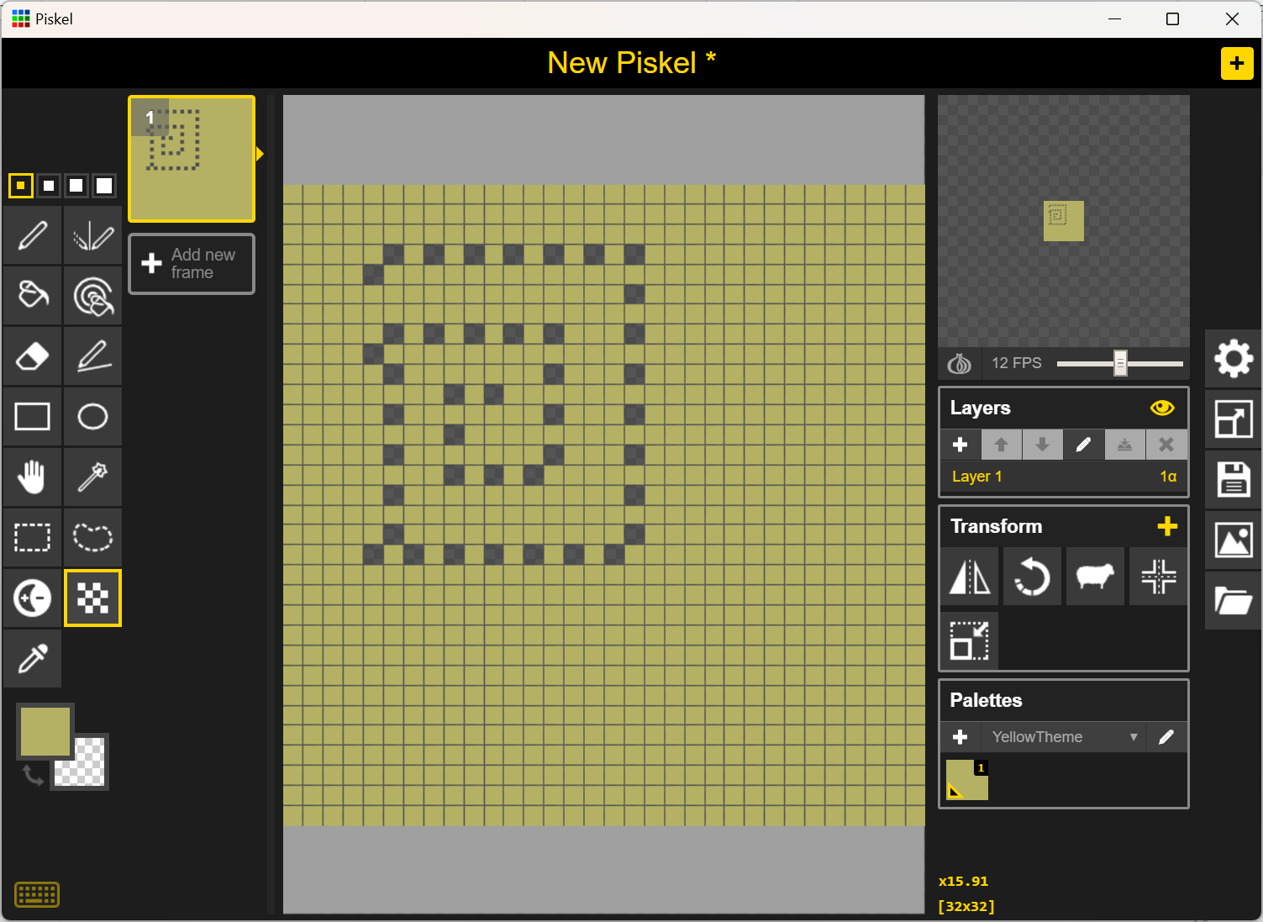
Piskel -> dithering tool,

Slide 24
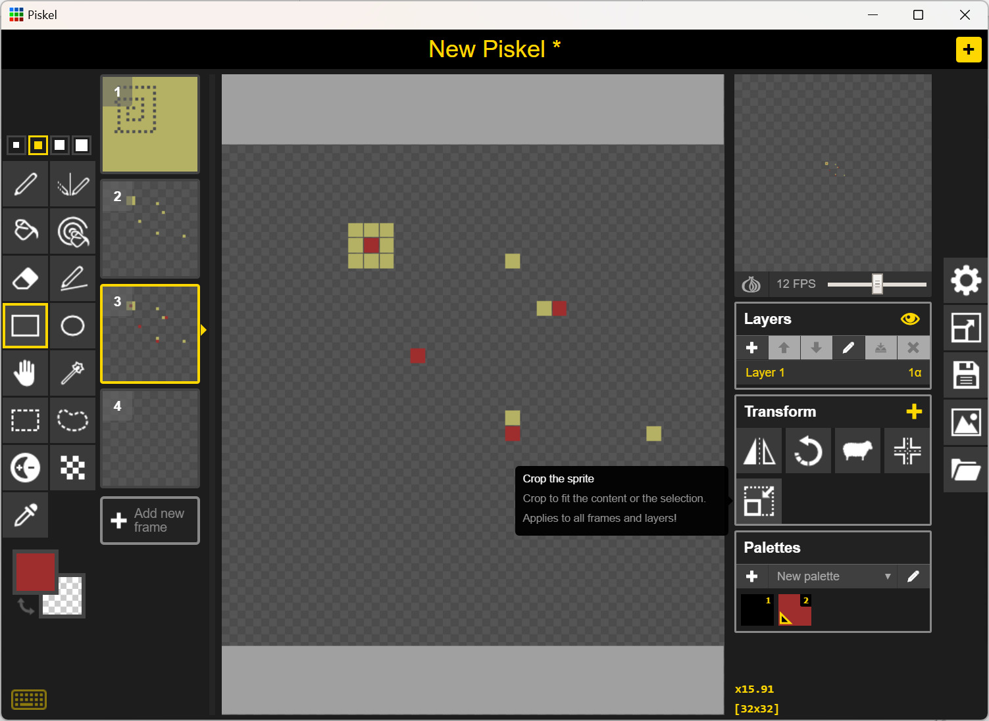
Piskel -> New Piskel two different colors

Slide 25
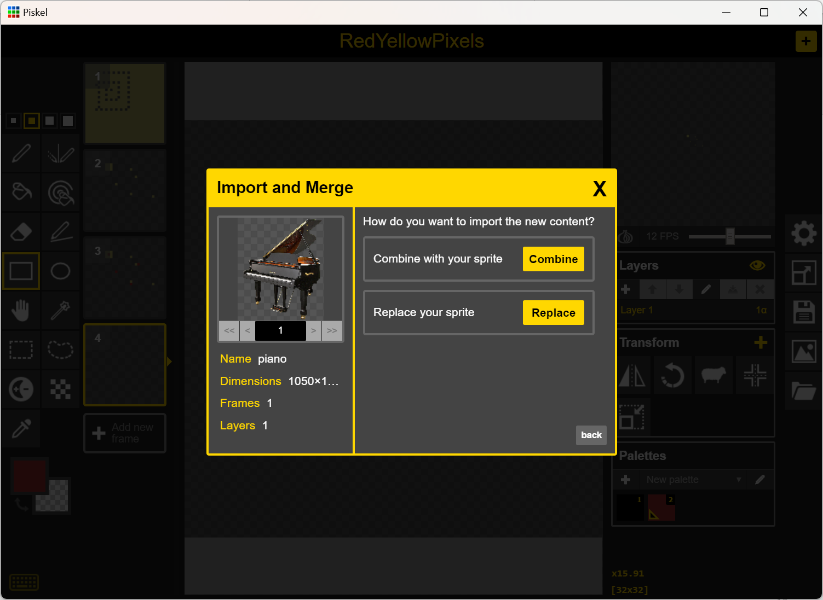
Piskel -> import an image

Slide 26
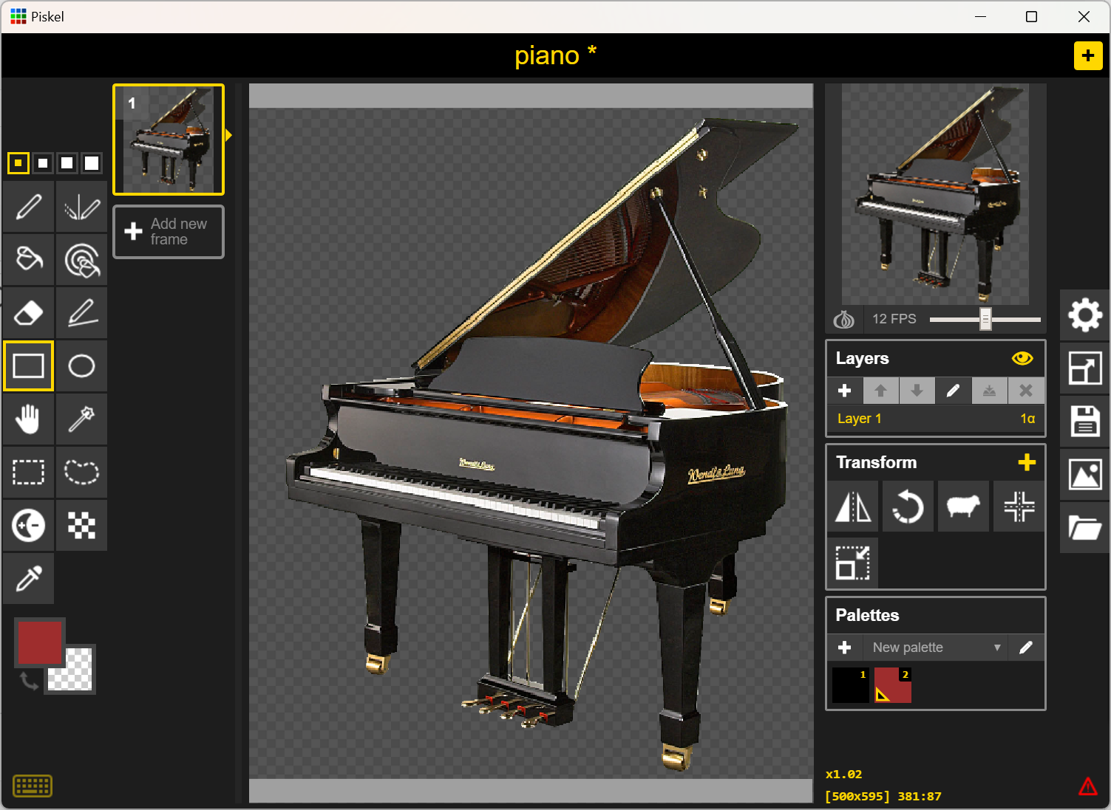
Piskel->Image of a piano

Slide 27
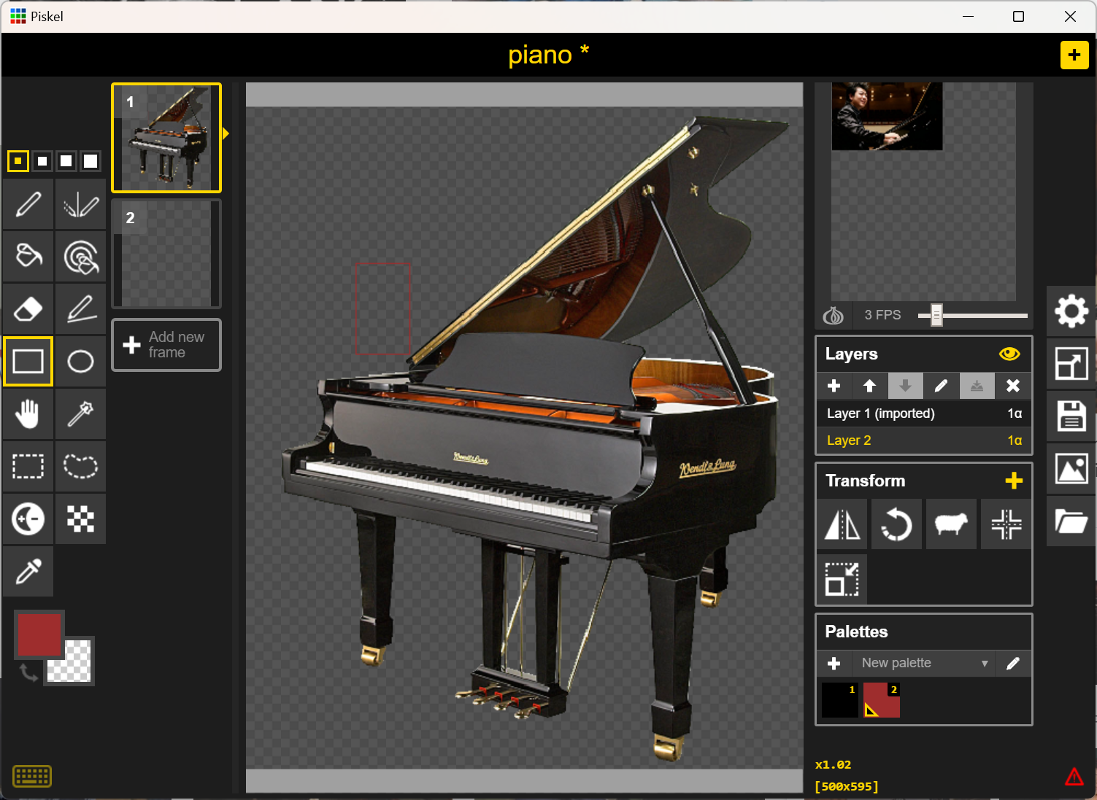

Piskel->Layering->add another graphic

Slide 28
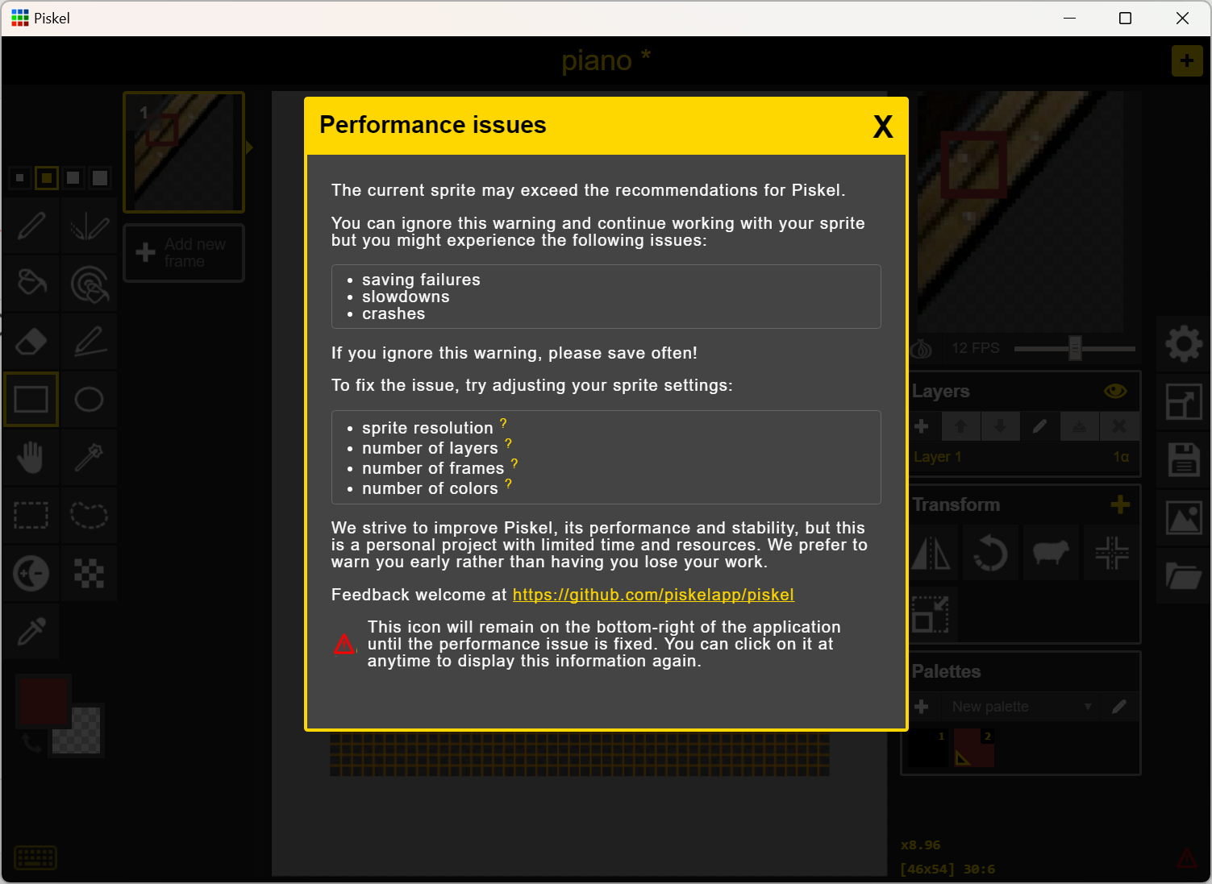
Piskel-> Performance Issues

Slide 29
Properties for the Image
Size (in pixels or percentage)
Background
Color(s)
Shape(s)
Theme(s)
Layout
Drawing tool: airbrush, pen
Effects: gradients

Slide 30
Save your image(s)!!!
File extensions that suggest an image file
.jpeg or .jpg Joint Photographic Experts Group
.bmp Bitmap
.gif Graphics Image Format
.png Portable Network Graphics
Learn about lossy compression versus lossless compression
Save your images/photographs in a folder!!

Slide 31









Anime – How to draw
1-Create Face basic structure
2- Add facial features
Eyes
Nose and Mouth
3- Draw the hair
4- Add the body
5- Add details ink your drawing

